Slide 1

HS3052 Capstone Project Design: Supplementary Document
Supervisor: Dr. Farshid Keivanian
Session 2: Capstone Essentials: Team Roles, Tools, Milestones, Preparation for Group Assignment 2 (Presentation), & Progress Tracking

Slide 2
Session 2’s Outline
Weekly Task Breakdown & Milestones
Weekly Gantt Chart
Project Team Roles and Responsibilities
Project Progress Checkpoints
Team Contract
Dealing with Member Delays in Communication
Tips for a Successful Proposal
Approach Meetings with Clear Objectives
Follow-Up and Documenting Requirements
Addressing Team Communication Issues
Literature Review Tips: What Makes It Strong?
Finding Scholarly Documents
Tools for Citation
Tools & Technologies to Use
Selected Capstone Topics – Sydney Campus
Recommended Tools & Technologies per Capstone Topic – Sydney
Preparation for Group Assignment 2 – Presentation
Group Progress Presentation – Overview of Progress at least 2 min

Slide 3
Weekly Task Breakdown & Milestones
Week | Tasks | Notes
1 | Finalise group & select topic | Choose from topics like Library Mgmt, Lost & Found, Feedback System, etc.
2 | Project Management Package (Assessment 1 due) | Scope, charter, WBS, Gantt chart – submit as a group
3–4 | Requirements analysis + Literature review | Collect references, interview users, gather data, start drafting RS
5 | Presentation of proposed solution (Assessment 2) | Slides + demo/mockup preview
6 | Submit Requirements Specification (Assessment 3) | System overview, diagrams, user stories, use cases, ERD, schema
7 | Prototype building begins | Setup tools, split coding and UI/UX tasks among group

Slide 4
Weekly Task Breakdown & Milestones
Week | Tasks | Notes
8–11 | Development + testing | Complete features, peer review, fix bugs, update documents
12 | Submit Final Prototype + Docs (Assessment 4) | Include testing report, user manual, installation guide, project closure plan

Slide 5
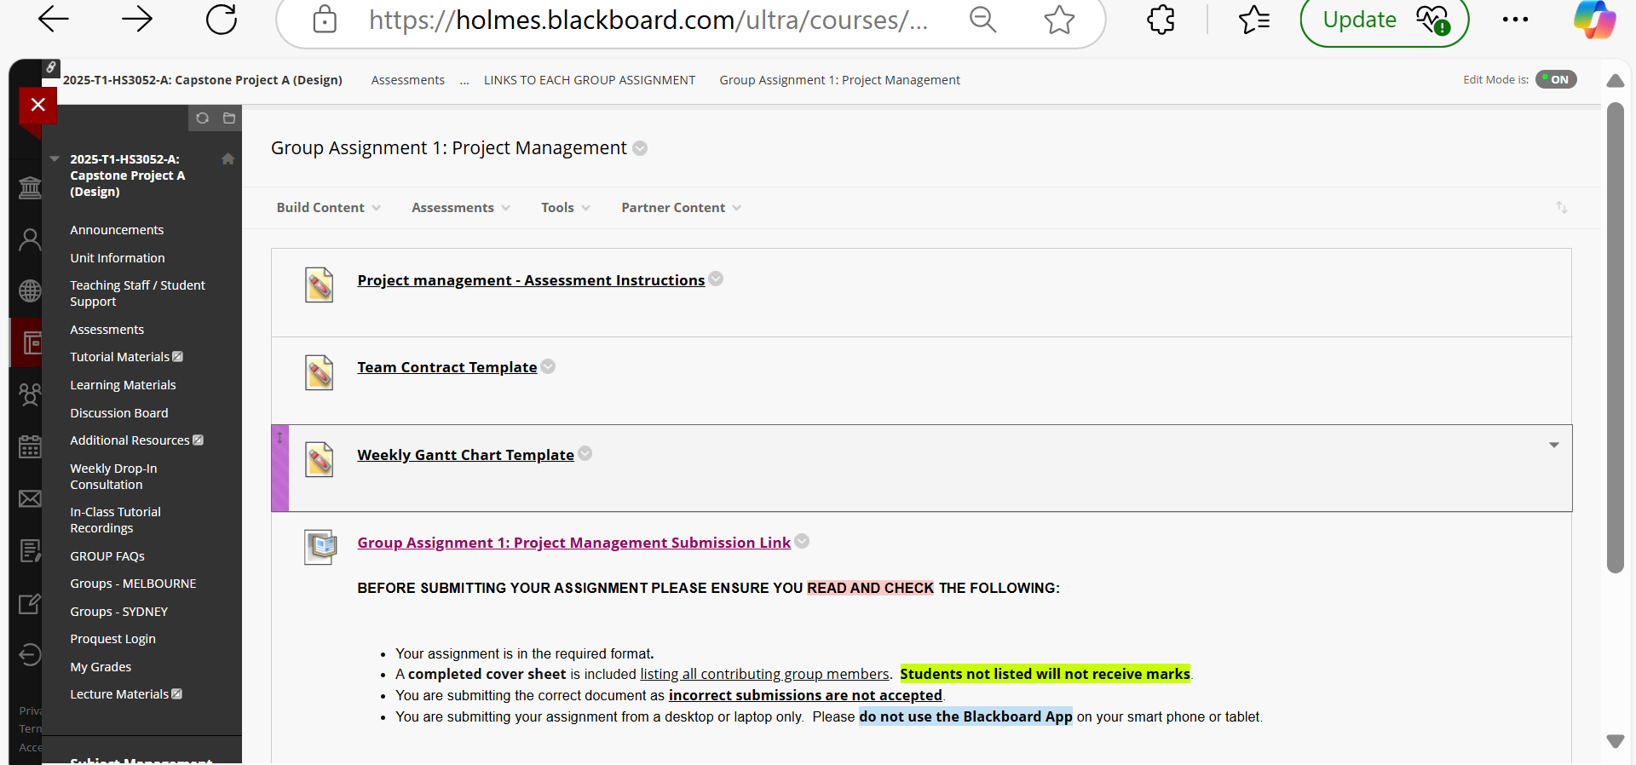
Weekly Gantt Chart

Slide 6
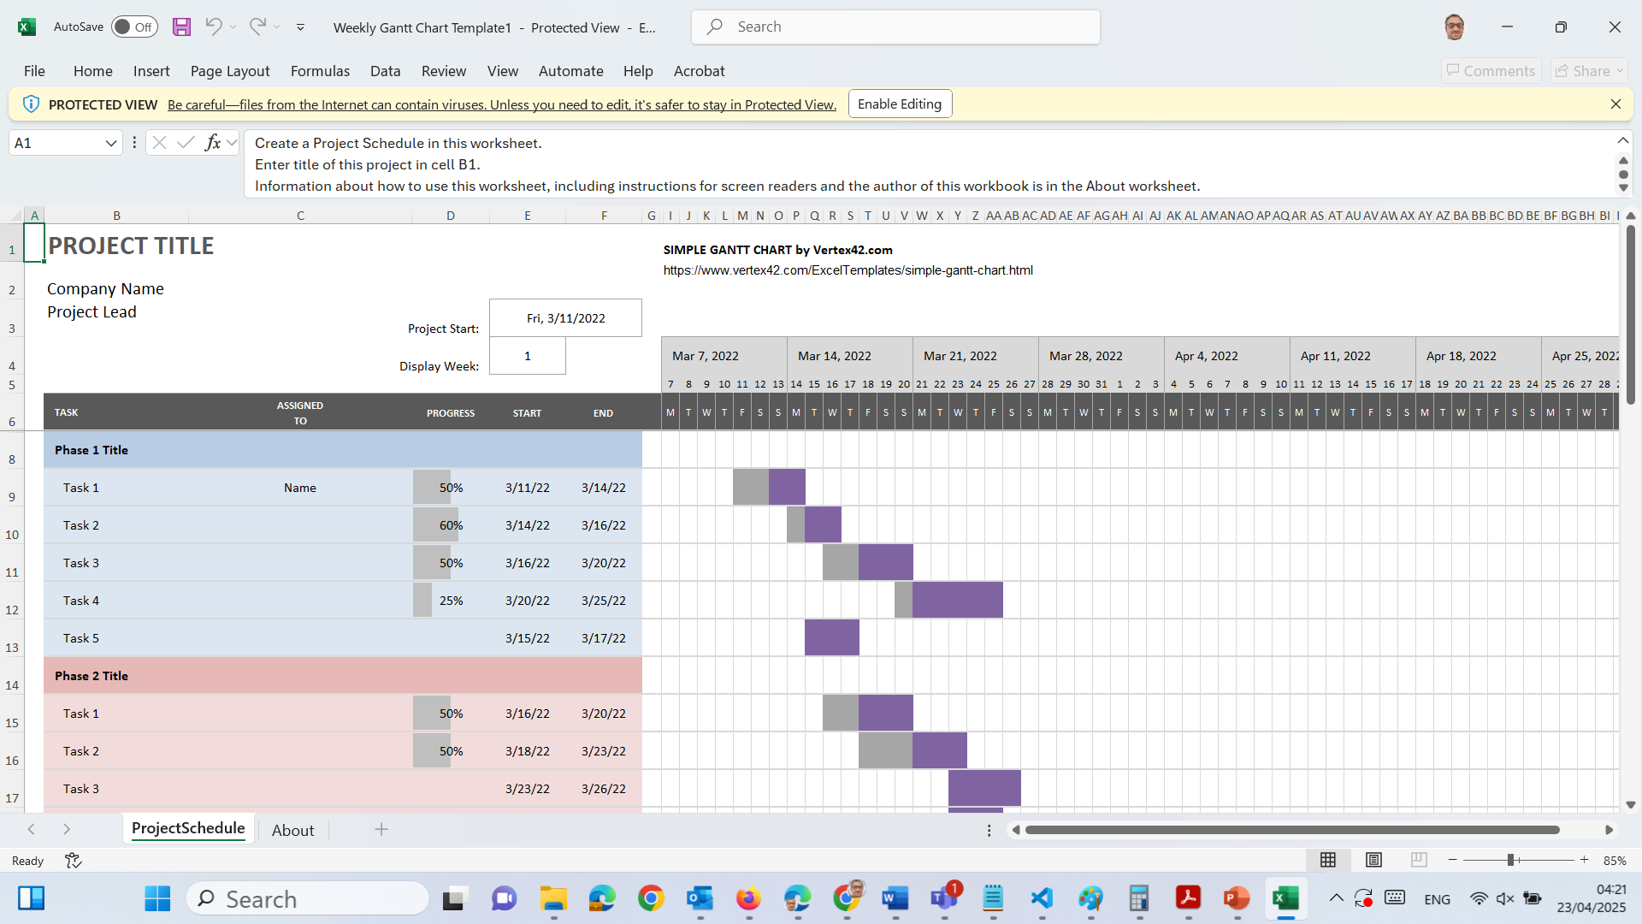
Weekly Gantt Chart

Slide 7
Project Team Roles and Responsibilities
Strategy: Assign roles and responsibilities clearly within the team to prevent overlap and confusion.
Action Steps:
Divide the project into tasks and assign each task to specific team members. Make sure each member knows their role.
Set internal deadlines to ensure each task is completed on time, and adjust as necessary to accommodate client delays.
Regularly update the project timeline to accommodate new information or shifts in priorities from the client.

Slide 8
Project Team Roles and Responsibilities
1. Literature Review Researcher
Role: Knowledge base builder
Responsibilities:
Conduct thorough research using academic papers, journals, reports, and books
Summarize findings on existing theories, models, technologies, or systems
Identify gaps in the literature that the project can address
Prepare the literature review section of the final report
Ensure proper referencing using the correct academic style (adaptive Harvard)

Slide 9
Project Team Roles and Responsibilities
2. Project Manager (PM)
Role: Coordinator and leader
Responsibilities:
Define project scope, timeline, milestones, and deliverables
Assign tasks and monitor progress of team members
Conduct team meetings and report on status
Ensure the project stays on track (time, budget, quality)
Serve as the main point of communication between team and stakeholders (e.g., supervisor, client)
Prepare project management documents (e.g., Gantt charts, risk assessments)

Slide 10
Project Team Roles and Responsibilities
3. Programmer / Developer
Role: Technical implementer
Responsibilities:
Design and write the codebase (backend, frontend, or both)
Choose appropriate programming languages, frameworks, and libraries
Test and debug the application
Integrate APIs, databases, or third-party tools if required
Document code and technical decisions
Ensure the system meets functional and non-functional requirements

Slide 11
Project Team Roles and Responsibilities
4. UX/UI Designer (Experience & Visual Design Lead)
Role: Designs the full user experience and visual interface of the product, ensuring usability, accessibility, and aesthetic consistency.
Responsibilities:
Conduct user research (e.g., interviews, surveys, persona development) to understand target users’ needs
Map user journeys and structure information architecture for intuitive navigation
Design wireframes, interactive prototypes, and high-fidelity mockups
Define and maintain a consistent design language (color palette, typography, layout, iconography)
Use tools such as Figma, Adobe XD, or Sketch to create responsive designs
Collaborate with developers to ensure accurate implementation of UI elements
Perform usability testing and refine designs based on user feedback
Ensure the product is accessible, inclusive, and user-friendly across all devices
Maintain and update the design system or style guide for the team
Review and approve all visual assets before deployment

Slide 12
Project Progress Checkpoints
Strategy: Monitor progress frequently to ensure the project stays on track and issues are addressed early.
Action Steps:
Schedule weekly review sessions to assess progress, address blockers, and make adjustments as needed.
Identify and document roadblocks immediately and develop contingency plans for delays or gaps in client communication.
Use performance metrics (e.g., tasks completed, milestones achieved) to evaluate progress and make necessary adjustments.

Slide 13
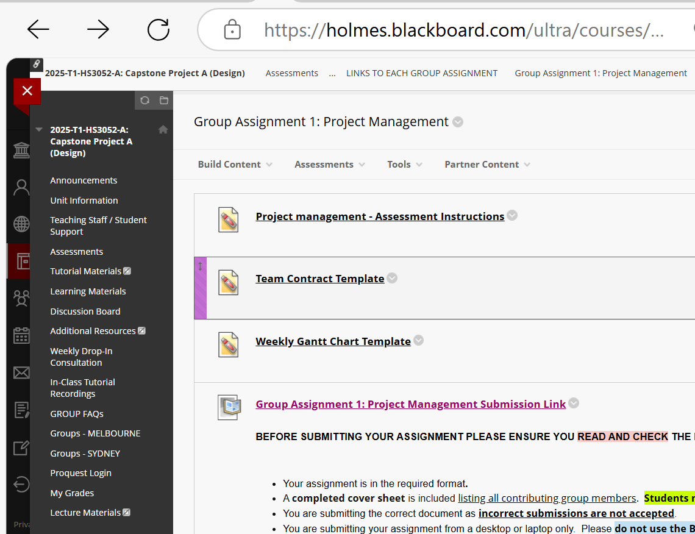
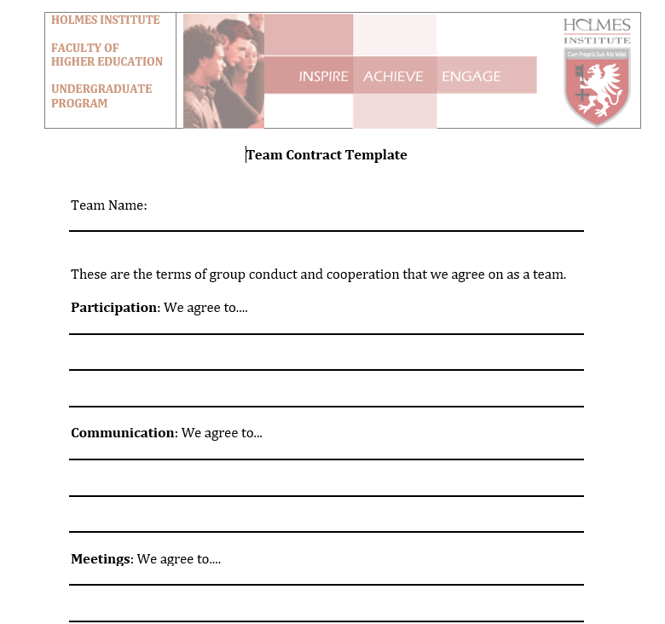
Team Contract

Slide 14
Dealing with Member Delays in Communication
Strategy: Proactively inform the member about the impact of their response delays on the project timeline.
Action Steps:
Politely communicate how delayed responses can impact the project’s schedule and potentially the budget.
Set clear deadlines for member feedback, emphasising that delays may lead to later project completion.
Document each communication attempt so you have a record if further escalation is required.

Slide 15
Tips for a Successful Proposal
Clarity and Conciseness: Be clear and to the point, especially in sections like the Executive Summary and Conclusion.
Visuals: Use visuals like Gantt charts effectively to present timelines.
Review and Proofread: Check for clarity, coherence, and grammar to ensure professionalism.

Slide 16
Approach Meetings with Clear Objectives
Strategy: Approach the meeting with a structured plan to gather as much relevant information as possible.
Action Steps:
Assign roles within the team (e.g., note-taker, questioner, observer) to cover different aspects of the discussion.
Request clarification on any vague requirements and ask for examples or use cases.
Confirm deliverables and timelines, and set expectations for communication frequency and preferred methods.

Slide 17
Follow-Up and Documenting Requirements
Strategy: Ensure that all team members are aligned on project goals and that there’s no ambiguity about client requirements.
Action Steps:
Create a summary document of the meeting, including key points, agreed deliverables, and timelines. Share this with the client and request confirmation.
Develop a requirements document that details every aspect of the project requirements, breaking them into specific tasks.
Distribute the document to all team members to ensure everyone has the same understanding and can refer back to it as needed.

Slide 18
Addressing Team Communication Issues
Strategy: Encourage open communication and create a structure for regular team updates.
Action Steps:
Hold regular team meetings, at least once a week, to discuss progress, challenges, and next steps.
Use collaborative tools (e.g., Slack, Microsoft Teams, or project management tools like Asana or Trello) to keep everyone informed and involved.
Implement a conflict resolution mechanism: Assign a mediator if miscommunication becomes a recurring issue among team members.

Slide 19
Literature Review Tips: What Makes It Strong?
Use at least 5–8 scholarly sources from the last 5–7 years.
Focus on gaps or limitations in existing systems.
Identify what's missing in current solutions (e.g., security flaws, poor UX, outdated tech).
Use Google Scholar, ACM Digital Library, IEEE Xplore, and ProQuest via Holmes Library.

Slide 20
Literature Review Tips: What Makes It Strong?
Key sections to include:
Introduction to your domain (e.g., Feedback Systems)
Comparative table of 3–5 existing systems
Analysis of best practices, strengths, and weaknesses
Identified gaps and justification for your proposed system

Slide 21
Literature Review Tips: What Makes It Strong?
Purpose:
Compare and contrast five scholarly articles related to the project topic.
Format:
Each article should be briefly summarized, focusing on lessons for your project.
Analyze what is beneficial and should be incorporated, and highlight aspects to avoid.

Slide 22
Literature Review Tips: What Makes It Strong?
Steps:
Select a research question relevant to your project topic.
Choose 5-8 scholarly articles.
For each article:
Provide a brief summary.
Discuss lessons for your current project.

Slide 23
Literature Review Tips: What Makes It Strong?
Example Entry Structure:
Article Title: Title of Article 1
Summary: Summarize the main findings and relevance.
Lessons for Current Project: Highlight applicable insights (both positive and negative).

Slide 24
Literature Review Tips: What Makes It Strong?
Conclusion:
Synthesize the findings from all articles:
Do they suggest a similar approach?
Do they offer conflicting views? What does this mean for your project?

Slide 25
Literature Review Tips: What Makes It Strong?
Technology Review (Part B)
Purpose:
Evaluate five to eight technologies relevant to the project.
Format:
Provide a brief summary of each technology.
Include screenshots (if applicable) to visually demonstrate functionalities.

Slide 26
Literature Review Tips: What Makes It Strong?
Steps:
Select five to eight aspects of the project (e.g., programming languages, databases, APIs, frameworks, or design tools, etc).
For each technology:
Name the technology.
Provide a summary of its features and how it addresses project needs.
Include relevant screenshots or diagrams.

Slide 27
Literature Review Tips: What Makes It Strong?
Comparison Table:
Compare all five technologies based on:
Features
Cost
Usability
Performance

Slide 28
Literature Review Tips: What Makes It Strong?
Example Table
Feature | Tech 1 (e.g., Zoom) | Tech 2 (e.g., Microsoft Teams) | Tech 3 (e.g., Google Meet) | Tech 4 (e.g., Cisco Webex) | Tech 5 (e.g., Slack)
Ease of Use | High | Medium | High | Low | High
Cost | Free | Paid | Free | Paid | Free
Usability | High | Medium | High | Medium | High
Performance | High | High | Medium | High | Medium
The technologies in parentheses are just examples; you can substitute these with the actual technologies being reviewed in your assessment.

Slide 29
Literature Review Tips: What Makes It Strong?
Recommendations
Justify the technology you would recommend for the project.
Explain why it best meets the requirements.

Slide 30
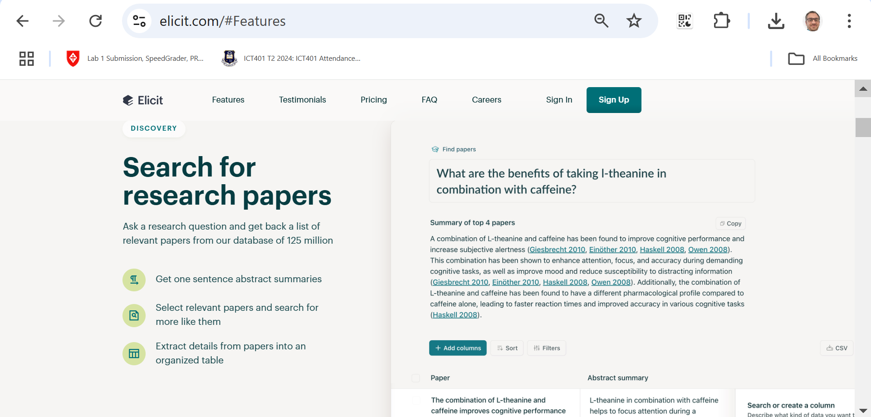
Finding Scholarly Documents
Sources Beyond the Library:
Google Advanced Search.
Google Scholar.
References in Wikipedia entries.
Tools like Elicit.

Slide 31
Finding Scholarly Documents
Introduction to Elicit
What is Elicit?
A free, AI-powered research tool (available at elicit.com) designed to assist with literature reviews and academic research.
Uses advanced AI (similar to ChatGPT) to understand search queries and extract meaningful information from academic papers.

Slide 32
Finding Scholarly Documents
Key Difference from Traditional Tools:
Unlike Google Scholar or library databases, Elicit interprets the intent of your query and summarizes results using AI.
Ideal for refining research questions, identifying trends, and narrowing literature focus.

Slide 33
Finding Scholarly Documents
Getting Started
Input a Research Question:
Begin with a broad or specific research question.
Example: What are the ethical implications of virtual reality in history education?
Elicit searches from a database of 175 million papers.

Slide 34
Finding Scholarly Documents
Explore Suggestions and Refine Queries:
Suggestions appear to refine or reframe the query.
Example: Potential risks of virtual reality in education.

Slide 35
Finding Scholarly Documents
Features of Elicit
Abstract Summaries:
AI-generated summaries of academic papers.
Useful for quick overviews but requires cross-checking with original sources to ensure accuracy.

Slide 36
Finding Scholarly Documents
Citation Information:
View citations, potential critiques, and how often a paper is referenced to assess its relevance.

Slide 37
Finding Scholarly Documents
Star and Organize Articles:
Mark important papers for later review.
Easily filter and review starred papers to track progress.

Slide 38
Finding Scholarly Documents
Advanced Filters:
Filter results by:
Publication date.
Study type (e.g., meta-analysis, reviews).
Population characteristics (e.g., K-12 students, educators).

Slide 39
Finding Scholarly Documents
Using Elicit for Research
Refining Research Focus:
Iteratively search for specific aspects (e.g., ethical implications, pedagogical impact) using suggested phrasing.
Example: Compare ethical dilemmas in VR vs. emotional responses in VR education.

Slide 40
Finding Scholarly Documents
Finding Key Details:
Identify participant demographics, technologies used, and study findings quickly.
Example: VR in Holocaust education encountered ethical dilemmas.

Slide 41
Finding Scholarly Documents
Tracking Methodology:
Elicit logs search terms and strategies, which can be referenced when documenting your literature review methodology.

Slide 42
Finding Scholarly Documents
Best Practices
Cross-Verify Information:
Abstract summaries are AI-generated; always verify by reading the original paper.

Slide 43
Finding Scholarly Documents
Maintain Academic Integrity:
Do not copy summaries directly; cite original sources appropriately.

Slide 44
Finding Scholarly Documents
Iterate and Experiment:
Use Elicit to explore alternative query phrasings for broader or narrower scopes.

Slide 45
Finding Scholarly Documents
Use as a Complementary Tool:
Combine Elicit with traditional databases for comprehensive results

Slide 46
Finding Scholarly Documents
Benefits and Ethical Considerations
Benefits:
Streamlines literature review process.
Highlights key findings and trends quickly.
Encourages refining research questions effectively.
Ethical Considerations:
Acknowledge original authors and avoid plagiarism.
Critically evaluate the reliability and completeness of AI summaries.

Slide 47
Finding Scholarly Documents
Conclusion
Elicit revolutionizes the way researchers approach literature reviews by offering an AI-powered, efficient search tool. While it provides a powerful means to streamline academic exploration, critical thinking and verification are essential to ensure scholarly rigor. Use it as a complementary tool to traditional methods, and always prioritize ethical research practices.

Slide 48
Tools for Citation
Tools for Citation:
Online Platform: ProQuest (Blackboard; contact library at Holmes to get username/password), Harvard Generator, EndNote Web, Google Scholar.
Software: Mendeley, EndNote.

Slide 49
Tools & Technologies to Use
Category | Suggested Tools
Web Development | HTML, CSS, JavaScript, PHP, Bootstrap, XAMPP, Node.js, MySQL
Mobile Development | Flutter, Dart, Android Studio, Firebase, SQLite
IDE/Code Editors | VS Code, IntelliJ IDEA 2024.3.4.1, Eclipse, NetBeans
Analytics/Dashboards | Power BI, Google Data Studio, SAP Analytics Cloud
Documentation | MS Word, Google Docs, Draw.io, Lucidchart
Testing & Prototyping | Postman, Swagger, Figma, Balsamiq, JUnit, Selenium
Collaboration | Trello, GitHub, Google Drive, Slack

Slide 50
Selected Capstone Topics – Sydney Campus
Topic 2 – Digital Lost & Found System Selected by: Assignment Group Sydney (S1): 04 Description: A web or mobile platform for students and staff to report and recover lost items. Users can log lost items with details and search reported found items. It may include notifications, image uploads, and location tagging.

Slide 51
Selected Capstone Topics – Sydney Campus
Topic 7 – Basic To-Do List Web Application Selected by: Assignment Group Sydney (S1): 02 Description: A task management tool that allows users to add, update, mark complete, and delete personal or group tasks. This project focuses on CRUD operations, basic authentication, and user-friendly design with prioritization.

Slide 52
Selected Capstone Topics – Sydney Campus
Topic 10 – An Online Quiz System Selected by: Assignment Group Sydney (S1): 05 Description: An interactive quiz platform for instructors to create quizzes and for students to complete them online. It may support question banks, automatic scoring, performance analytics, and time-based quizzes.

Slide 53
Selected Capstone Topics – Sydney Campus
These projects align with common capstone objectives, such as demonstrating:
Full-stack development skills (frontend + backend)
User authentication and database integration
Data flow and user interaction design
Security and user data handling
Team collaboration and project management

Slide 54
Recommended Tools & Technologies per Capstone Topic – Sydney
Topic | Recommended Technologies
Digital Lost & Found System | XAMPP (Apache + MySQL), HTML, CSS, JS, PHP, Bootstrap
Basic To-Do List App | XAMPP, HTML, CSS, JS (possibly AJAX), PHP
Online Quiz System | XAMPP, HTML, CSS, PHP, MySQL, JS, jQuery (for timers/validation)

Slide 55
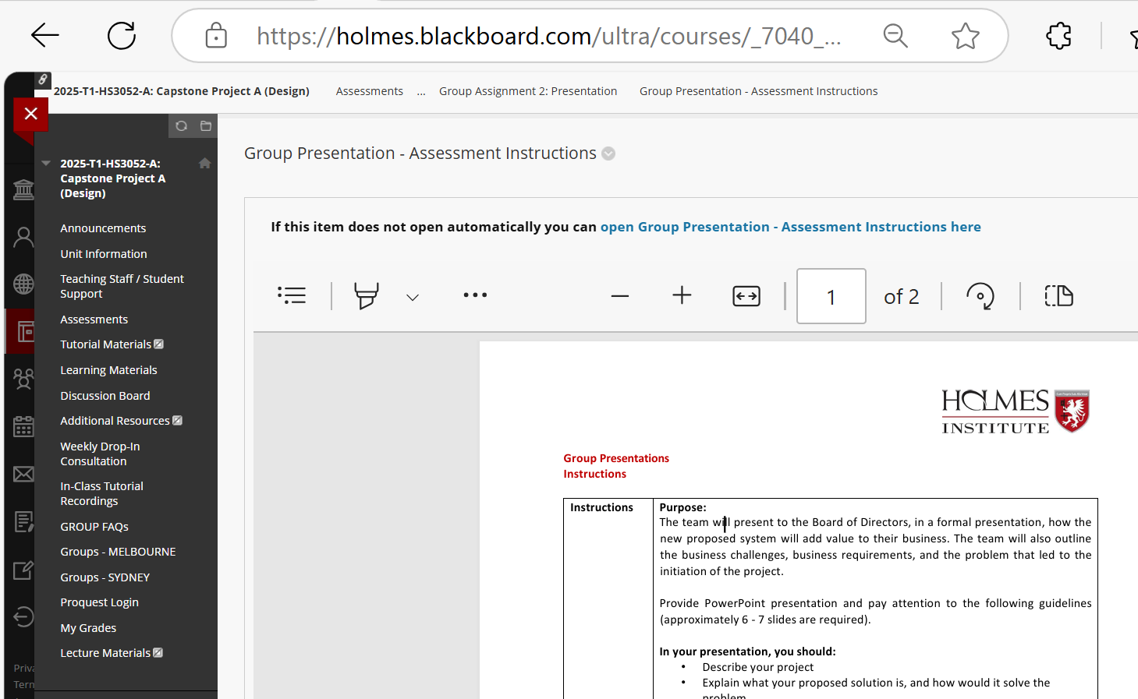
Preparation for Group Assignment 2 – Presentation
Presentation Instruction

Slide 56
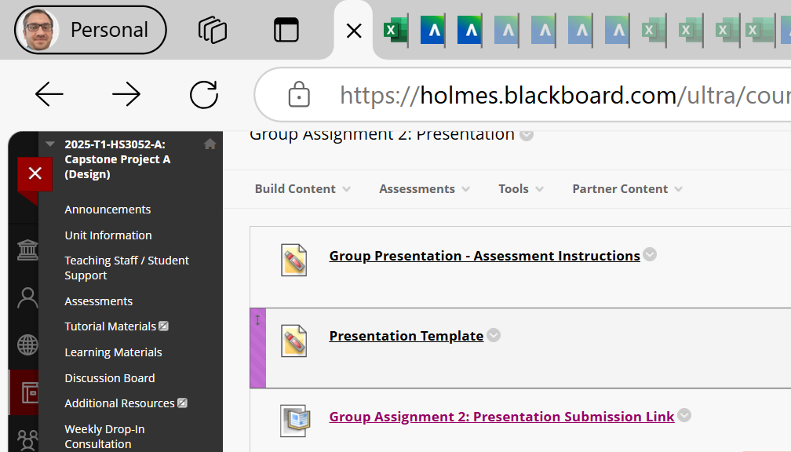
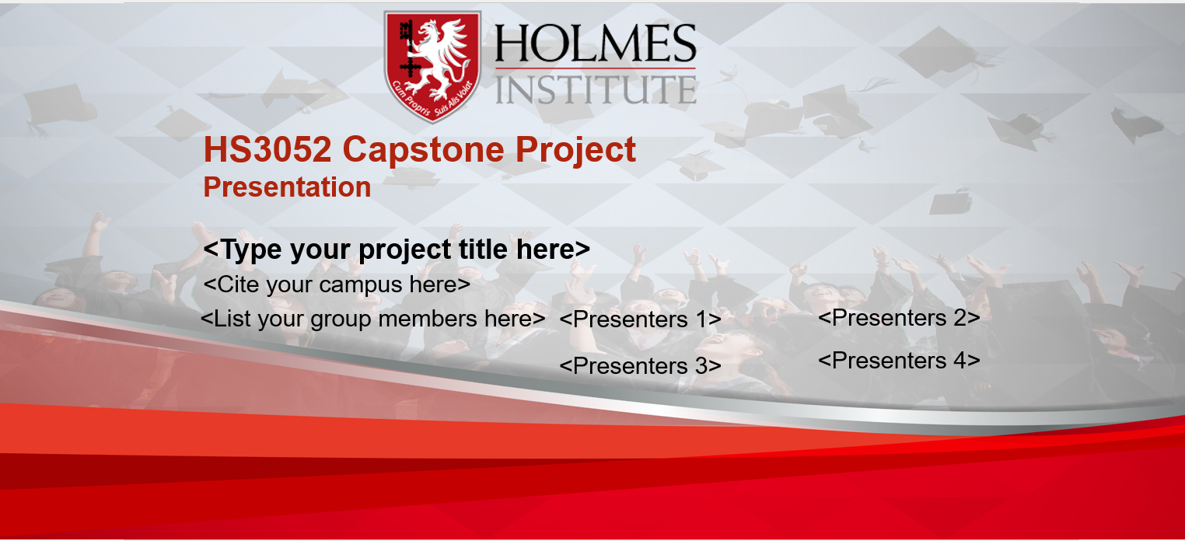
Preparation for Group Assignment 2 – Presentation
Presentation Template

Slide 57
Preparation for Group Assignment 2 – Presentation
Submission Mode: Via Blackboard (Max file size: 5MB) Alternative: Upload to YouTube (public link) & submit the link in a Word document.
Purpose of the Presentation
You are presenting to a simulated Board of Directors to convince them that your system:
Solves a business problem
Adds tangible value
Is technically sound and feasible

Slide 58
Preparation for Group Assignment 2 – Presentation
What to Include (6–7 Slides Recommended)
Slide 1: Introduction
Team name & group number
Project title and a brief overview
Team member roles (e.g. Developer, UX Designer)

Slide 59
Preparation for Group Assignment 2 – Presentation
Slide 2: Problem Statement
What problem does your system solve?
Whose problem is it (e.g. students, staff, customers)?

Slide 60
Preparation for Group Assignment 2 – Presentation
Slide 3: Proposed Solution
Describe the system’s main features
Technologies used (e.g., XAMPP, HTML/CSS/JS/PHP, MySQL)
How the solution solves the problem

Slide 61
Preparation for Group Assignment 2 – Presentation
Slide 4: System Breakdown
Show system modules (Login, Admin Panel, User Dashboard)
Use diagrams if possible (use draw.io, Lucidchart, etc.)
Mention use of database tables if applicable

Slide 62
Preparation for Group Assignment 2 – Presentation
Slide 5: Sample Screens & Platform
Include 2-3 wireframes or UI mockups (can be Figma/Adobe XD or coded sketches)
Indicate whether it’s a website, app, or hybrid

Slide 63
Preparation for Group Assignment 2 – Presentation
Slide 6: Gantt Chart & Timeline
Show weekly progress breakdown (Week 1 to Week 14)
Assign tasks to members
Mark deadlines and milestones clearly

Slide 64
Preparation for Group Assignment 2 – Presentation
Slide 7: Challenges & Risks
Mention obstacles (e.g. availability, tech limitations, skill gaps)
Mitigation strategies

Slide 65
Preparation for Group Assignment 2 – Presentation
Slide 8: Conclusion & Next Steps
Summary of benefits
What will be done before the next submission
Call-to-action or thank you

Slide 66
Preparation for Group Assignment 2 – Presentation
Marking Criteria
Criteria | Weight
Structure & Flow | 20%
Coverage of Key Points | 25%
Summary & Conclusion | 15%
Delivery & Speaking Style | 20%
Technical Accuracy | 20%

Slide 67
Preparation for Group Assignment 2 – Presentation
What to Avoid
❌ Submitting a video larger than 5MB directly to Blackboard
❌ Missing team members on the cover sheet (those not listed = no marks)
❌ Reading slides word-for-word
❌ Submitting from phones or using Blackboard App
❌ Lack of visuals (slides should not be just text!)

Slide 68
Preparation for Group Assignment 2 – Presentation
Tips & Hints
Practice your 2-minute part before recording or going live
Ensure one person submits on behalf of the group
Label each slide clearly with the topic
For YouTube: set visibility to Unlisted or Public, not Private
Check that the video link works
Follow Holmes formatting: 11-pt Calibri, clear naming (e.g., HS3052-S1-Group04)

Slide 69
Preparation for Group Assignment 2 – Presentation
Reminder of Your Selected Topics (Sydney)
From the topic sheet:
Group 04 – Digital Lost & Found System
Group 02 – Basic To-Do List Web Application
Group 05 – Online Quiz System
Make sure your presentation directly aligns with the selected system!

Slide 70
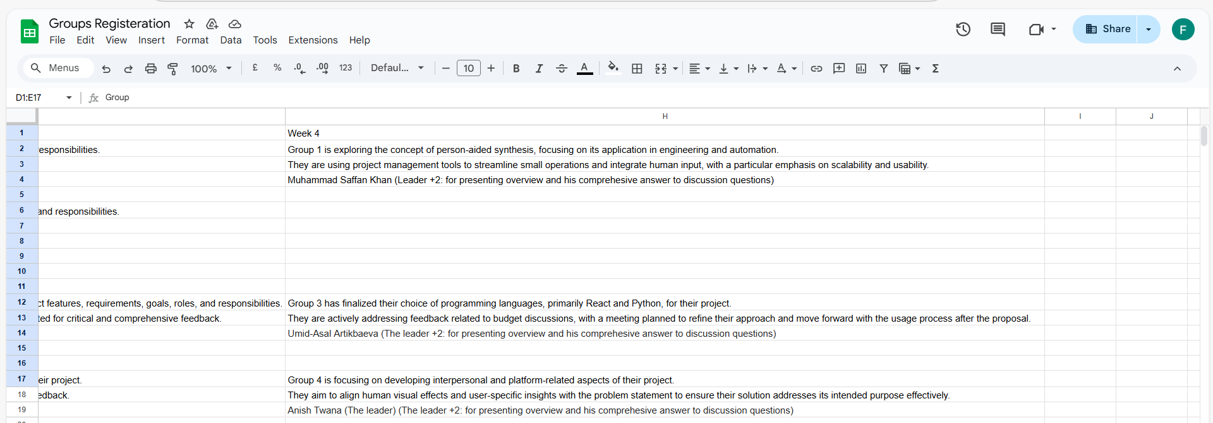
Group Progress Presentation – Overview of Progress at least 2 min

Slide 71
Thank You
Need Help? Send an email or ask during the tutorial session.
Good luck with your capstone journey!
Dr. Farshid Keivanian Capstone Project Supervisor farshid.keivanian@holmes.edu.au

